Slide 1
Comparison of Tree based Learners in Incremental Dataset of Software Defect Predictions
Md Rayhanur Rahman

Slide 2
Motivation
Software Source Code evolves - so does the source code metrics
Software Defect Prediction works on top of those metrics
Learners need to relearn everything as the source code changes
Relearning from scratch is not cost effective due to starting over things as soon as source code gets committed
On top of this, if the dataset gets larger and larger, relearning can become infeasible
Intuitively, Decision Trees, Random Forests suffer such aforementioned problem
What if we deploy an incremental/online/stream based decision tree based learner…???

Slide 3
Research Questions
Three non-streaming learners (CART, RF & FFT) vs one streaming learner (VFDT) will be deployed to predict software defects from datasets that will be fed to the learners with increasing numbers of examples
We want to observe…
Their prediction performance in defect prediction (RQ1)
Impact of parameter tuning on their performance (RQ2)
The computational resource usage (RQ3)

Slide 4
Baselines Targeted
Usefulness
Stable
Cheap
Streaming
Robust

Slide 5
Learners Used for Comparison
Classification and Regression Tree (CART)
Random Forest (RF)
Fast Frugal Tree (FFT)
Very Fast Decision Tree (VFDT) [1]

Slide 6
How VFDT Works...
It keeps consuming examples until the hoeffding bound is reaches
Reaching hoeffding bound means
With the probability of 1 - δ, the true mean of a random variable r is at least r’ - ε where,
ε² = R²ln(1/δ)/2n
To find the best attribute in a node, calculate the information gain of all the attributes when a new examples comes and rank the attributes from best to worst
If the difference of top two attribute’s information gain is bigger than the ε, we can split.
If not, we have to stream in more examples unless the bound satisfies
Do it recursively from top to bottom

Slide 7
Datasets
Software defect prediction datasets
Class label is Bugs and value is either 0 or 1
Attributes are software code metrics
Four datasets:
Abinit (around 90,000 examples, 27 attributes)
Lammps (around 42,000 examples, 40 attributes)
Libmesh (around 25,000 examples, 40 attributes)
Mdanalysis (around 10,000 examples, 37 attributes)
Source: https://github.com/se4sci/defect-prediction/tree/master/src/data/turk_labeled

Slide 8
Preparing the Datasets
From each dataset, 10 different training and test sets were generated
Test sets include 10 different set containing 20% of the original dataset
Training sets include 10 different set containing 80% of the original dataset
As the dataset were originally obtained sequentially, no stratification is applied
10-fold cross validation is not done as learners will be fed increasing number of examples in each pass
All the learners will be fed these following amount of examples from each of the 10 training set for all of the 4 datasets:
.01%, .02%, …, .1%, .2%, …, 1%, 5%, 10%, …., 95%, 100%
This is how streaming of larger and larger set of training examples is simulated for the learner

Slide 9
Parameter Tuning
Differential Evolution [2] Method is applied
Ranges of the parameters for different learners
Parameters | Ranges | Learners
Number of Estimator | 10 to 100 | RF
Maximum Depth | 2 to 10 | CART, RF, VFDT
Minimum Number of Examples to Split | 0 to 1, 5 to 500 | CART, RF, VFDT
Minimum Number of Examples at Leaf | 0 to 1 | CART, RF
τ | .001 to .99 | VFDT
n_{min} | 5 to 500 | VFDT

Slide 10
Evaluation Criteria
Prediction Performance
Precision
Recall
False Alarm
Computer Resource
Training Execution Time
Primary Memory Consumption

Slide 11
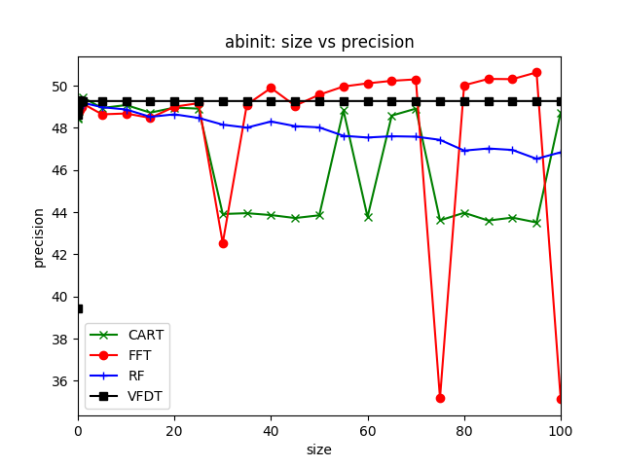
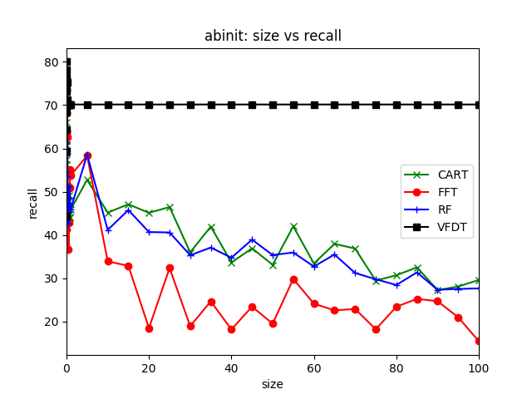
Dataset: Abinit

Slide 12
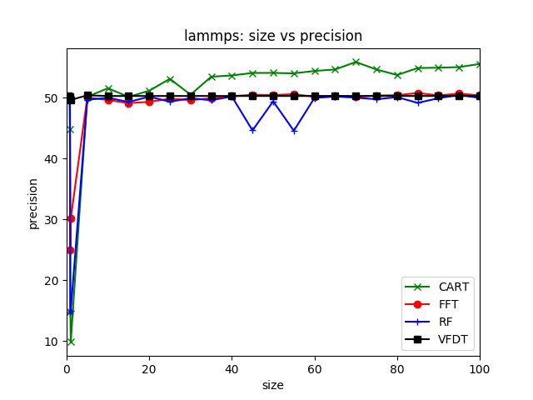
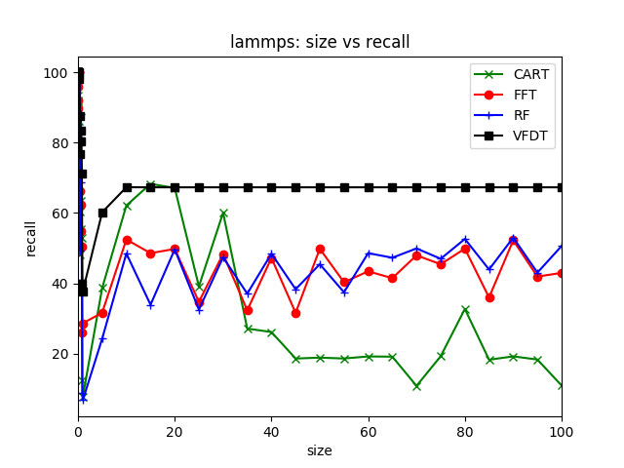
Dataset: Lammps

Slide 13
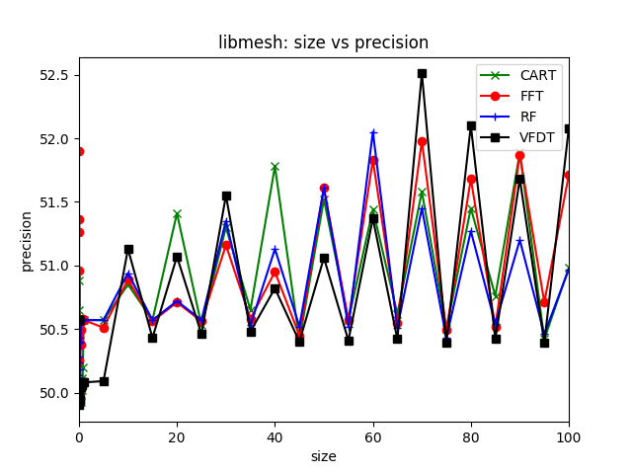
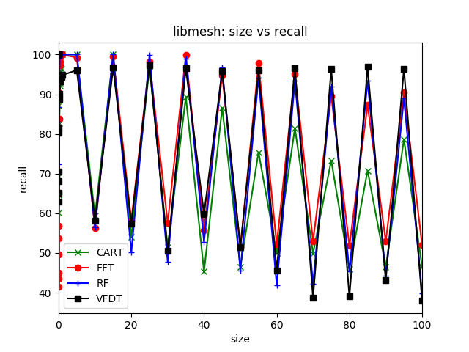
Dataset: Libmesh

Slide 14
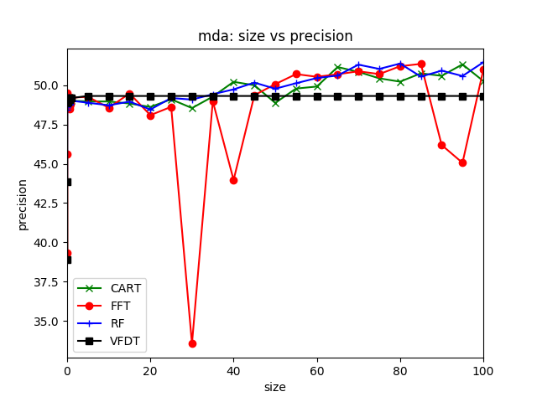
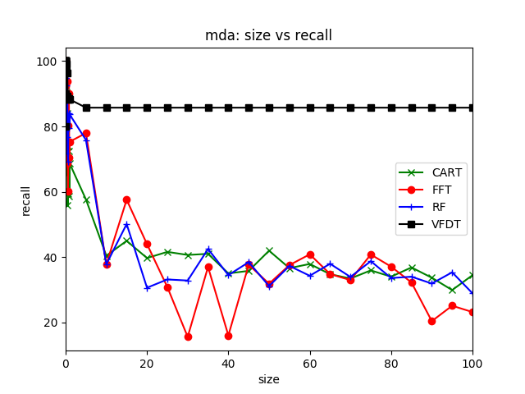
Dataset: Mdanalysis

Slide 15
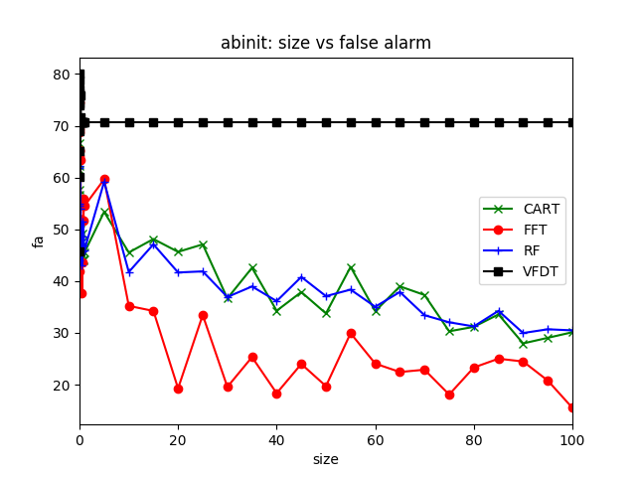
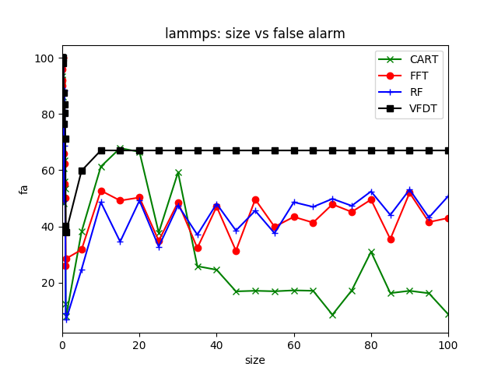
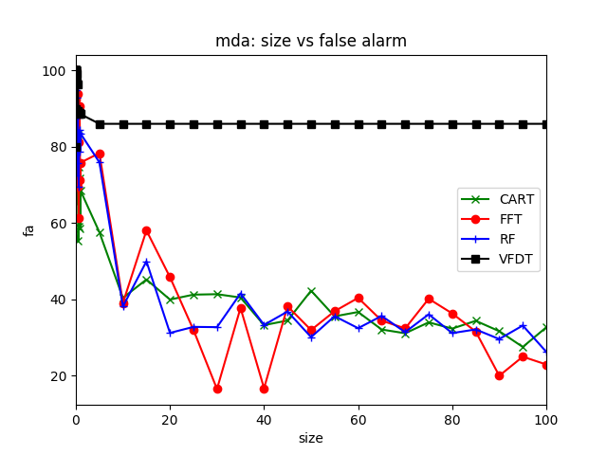
False Alarm for All Datasets

Slide 16

False Alarm for All Datasets

Slide 17
AUC of (size, precision) and (size,recall)
Dataset | Plane | CART | FFT | RF | VFDT
Abinit | size,prec | 4606 | 4816 | 4785 | 4926
Abinit | size,rec | 3769 | 2632 | 3620 | 7014
Lammps | size,prec | 5246 | 4969 | 4855 | 5026
Lammps | size,rec | 3091 | 4338 | 4336 | 6653
Libmesh | size,prec | 5097 | 5096 | 5087 | 5090
Libmesh | size,rec | 6864 | 7576 | 7265 | 7368
Mdanalysis | size,prec | 4979 | 4835 | 4996 | 4929
Mdanalysis | size,rec | 3928 | 3691 | 3908 | 8585

Slide 18
RQ1: Performance in Defect Prediction
Precision is overall similar for all learners across all datasets
But precision is not very far away from the random guess
Recall and False Alarm varies for datasets and learners
However, VFDT yields both better recall rate and fluctuate less than the others
False Alarm rates and recall rates are more or less similar to the recall score of the learners
VFDT’s stable recall rate is due to the reason of reaching hoeffding bounds down to the maximum depth

Slide 19
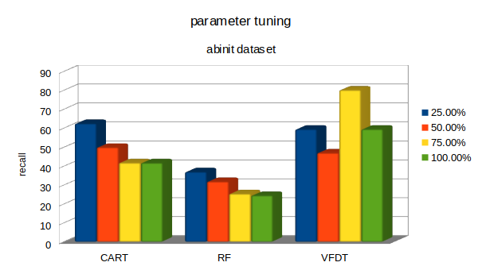
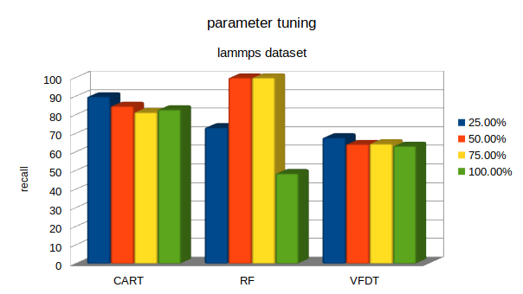
Parameter Tuning at Different Size

Slide 20
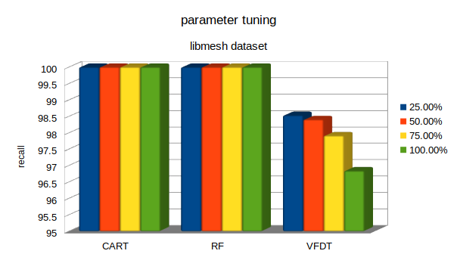
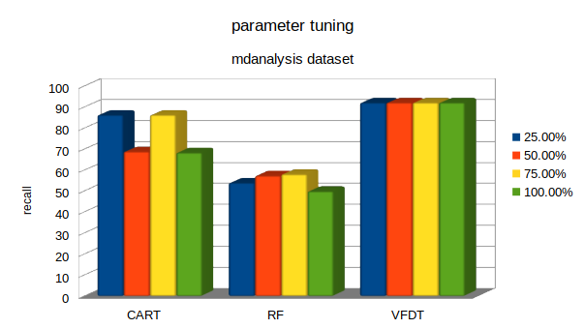
Parameter Tuning at Different Size

Slide 21
RQ2: Impact of parameter tuning
For better result, tuning can be done
But with streaming data, it’s not very practical
However, VFDT doesn’t gain much on parameter tuning compared to other two learners

Slide 22
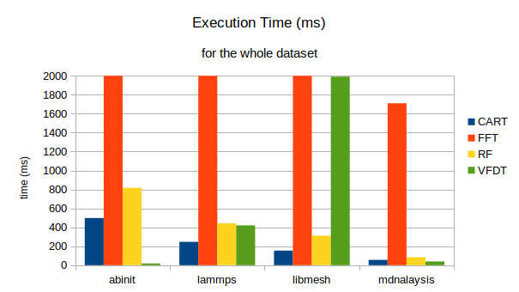
Execution Time
VFDT is fastest overall (one exception), FFT is the slowest. n_{min} dominates the execution time of VFDT

Slide 23
Memory Consumption
CART and RF consumed 168MB when learning from the whole abinit dataset
FFT and VFDT consumed 276 and 288 MB respectively
However, this comparison is not fair because,
The implementation of FFT and BFDT isn’t as efficient as scikit-learn + numpy
Python garbage collection mechanism does not release memory as soon as the variables become useless

Slide 24
Review in terms of Baselines
In terms of precision, not very useful. In terms of recall, VFDT is much more useful than the other three
VFDT behaves much more stable than the other three
While learning from newer and newer example consistently, VFDT is more robust
Theoretically, VFDT is computationally cheaper but parameters have to be set accordingly
VFDT is a practical option to stream in large number of examples for learning

Slide 25
Discussion and Future Work
VFDT performed better but not that meaningfully better
Poor precision
Poor false alarm
Large datasets can confuse the learner. For example:, observed zigzag in libmesh dataset
Need for re-learn
Need to change the tree
VFDT is static, C-VFDT can be a better choice for such scenario
VFDT is fast but can be made much much faster using multi-core processing
The effectiveness of VFDT and C-VFDT can be explored in Scalable Planners based on software defect prediction

Slide 26
References
Mining high-speed data streams - Domingos. Pedro and Hulten, Geoff. ACM SIGKDD - 2000
Differential Evolution – A Simple and Efficient Heuristic for global Optimization over Continuous Spaces. Rainer S, Kenneth P. Journal of Global Optimization - 1997

